Slide 1
WorkWell Overview

Slide 2
WorkWell West
Where – Bristol, North Somerset and South Gloucestershire
Launched on 1st October 2024
How do I refer – www.workwellwest.org

Slide 3
WorkWell West – What is it?
The WorkWell West programme is a partnership between BNSSG ICB, Bristol City Council (Primary Delivery Partner) and DWP. Expanding partnership.
1
It represents £2.9m of inward investment from DWP and was originally announced in the Budget of Autum 2023
2
It will run from October 2024 until 31st March 2026
3
It will operate in BNSSG ICB area – Bristol, North Somerset and South Gloucestershire
4

Slide 4
WorkWell – The 15 Pilot Areas
South Yorkshire | Cambridgeshire and Peterborough
Lancashire and South Cumbria | Surrey Heartlands
Greater Manchester | Frimley
Leicester, Leicestershire and Rutland | North West London
Coventry and Warwickshire | North Central London
Hereford and Worcestershire | Bristol, North Somerset and South Gloucestershire
Black Country | Cornwall
Birmingham and Solihull
Notes:
PA providing this on a map

Slide 5
WorkWell Key Objectives
To work with 3000 participants who are either at risk of losing their jobs or are unemployed due to their health condition
To strategically join “work and health” across the region and produce / implement a strategy to underpin this
To develop and contribute to the development of “Best Practice” in the area of assisting people with health conditions to maintain or obtain paid employment both regionally – and nationally with the other 14 WorkWell Vanguard Partnership Areas

Slide 6
WorkWell West – Priority people and areas
To identify these we analysed the Fit Note data for the BNSSG area
People – Priority participants are those with either mental health or muscular skeleton conditions. Stage 1 will focus primarily on Mental Health.
Areas –
North Somerset:- W-s-M Central, South and Haywood's Village.
South Gloucestershire:- Staple Hill, Kingswood, and Cadbury Heath
Bristol:- South, East and Inner City.

Slide 8
WorWkWorkWeWll West Participant Journey
Why WorkWell?
Health and work support for workers in a challenging landscape
Achieving sustainable employment
Preventative, early intervention measures
Alleviation of pressure on public services

Slide 9
Person in work at risk of losing their job due to their health condition
Person recently out of work due to their low-level health condition
GP / health professional
Community & VCSE services
Social prescribing teams
Council services (e.g. Housing, Social Care, Employment & Skills)
Employers & Employer Bodies (TU; CCI; FSB)
Health promotion services
Debt / benefit advice / financial services
Job Centre Plus services
National Careers Service
Local/regional employment support services including Skills Connect, Future Bright and WE Work for Everyone (including websites)
Education and Training services
Apprenticeships
Ongoing referral to more intensive support e.g. Universal Support, Access to Work, IPS, Restart etc.
Wraparound services e.g. housing, transport, childcare, finance support
1
Referral
www.workwellwest.org
workwell@bristol.gov.uk
0117 922 3623
2
Triage
Eligible
Ineligible
3
Support
Initial assessment with Work and Health Coach and creation of Return to Work Plan / Thrive in Work Plan
Multi-disciplinary in-house support may include:
Employer liaison
Work and health coaching
Advice on workplace adjustments
Regular follow up on Action Plan with Work and Health Coach
Triage, signposting and referral
Procured / grant funded or existing services
4
Completion
Action plan goals achieved. Example actions include return to work, remain in work, reduced health barriers to working, looking for work.

Slide 10
Aligning resources for impact – Q&A
What if someone recently out of work with poor mental health contacts the Skills Connect service for support?
How might someone registered with WorkWell benefit from Skills Connect services?
How will WorkWell clients be able to benefit from wraparound support e.g. mental health counselling?

Slide 11
Working towards a single system
Building a regional and local work and health offer which includes WorkWell, the new Universal Support Service and other government funded work and health services (e.g. Social Prescribing; Vitaminds Employment Service; AWP IPS Service)?
Creating a single ‘one front door’ for all health and work services – including shared information, assessment and referral processes (whilst managing data protection and working within GDPR rules)?

Slide 12
WorkWorkWeWll West Participant Journey
WorkWell Offer
Indicative timeframe: 6 months
Journey category | Examples of support
Find work | Job searching CVs Applications Interviews
Return to work | Sickness absence process (including 'Fit notes' / meetings) Return to work plans Reasonable adjustments
Thrive in work | Challenging processes at work including change, flexibility, relationships Managing health at work Workload/stress

Slide 13
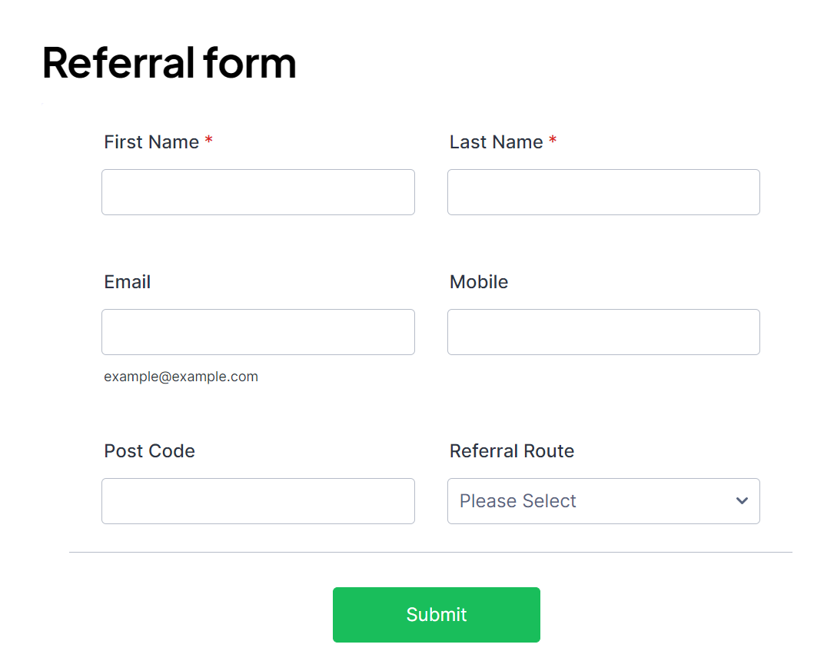
WorWkWorkWeWll West Participant Journey
www.workwellwest.org

Slide 14
Questions
Referral
www.workwellwest.org
workwell@bristol.gov.uk
0117 922 3623

